Slide 1
October IBOS meeting
Márcia Sipavicius Seide
2025

Slide 2
PREVIOUS TERM ACTIVITIES

Slide 3
2021 - Creation of the following protocols of research
Anthroponymic research in Russia from 2011 to 2021
Responsible: Anna Tsepkova

Slide 4
2021-2022 - Creation of the following protocols and resulting selected lists
2.1 Anthroponymic research in Mexico from 1970 to 2021 by
Yolanda Guillermina López Franco
2.2 Romanian onomastic bibliography +international onomastic bibliography by Responsible: Oliviu Felecan

Slide 5
2024 - Creation of the following protocols of research and resulting selected lists
5.1 Contemporary research on Cuban anthroponomastics
Responsible: Luis Ramón Campo Yumar

Slide 6
Aims of the term 2024-2027
To write and publish review article using as part of the data base the same set of journals indexed in Scopuss. Non indexed articles can also be included in the data base.
Sistematic review article: research questions, protocol, selected list of article, articles evaluation,research answer, writting of the article.
Traditional review article: research questions, articles selected by researcher at his or her discretion, articles evaluation,research answer, writting of the article.

Slide 7
Write and publish protocol and resulted selected list about onomastic research from Czech and South Africa.
To write and publish review article using as data base books about Onomastics.
Once the articles are published, in IBOS website for difusion under the heading “Review articles”.
News and potocols and lists of seleted articles will also be published in IBOS website.

Slide 8
New heading:
Articles review
Itens to be published
Articles reviews already published by Seide and Fernández-Juncal
Other members reviews already published by IBOS members M
News articles reviews – international reviews using as part of the data-base ONOMA jornal and journals recommend by ICOS and already indexed in Scopus. The article should be published in a jornal indexed in Scopus.

Slide 9
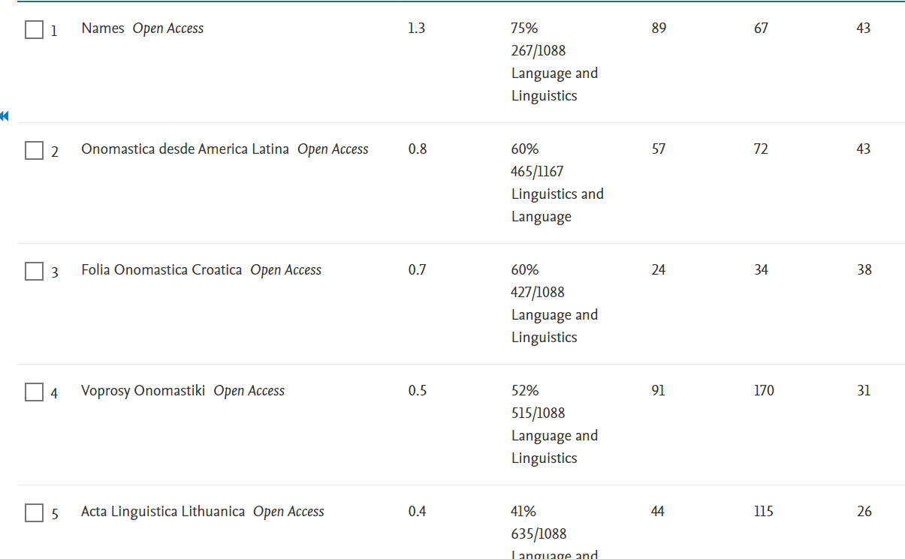
CITESCORE 2020-2023- Journals indexed in Scopus

Slide 10
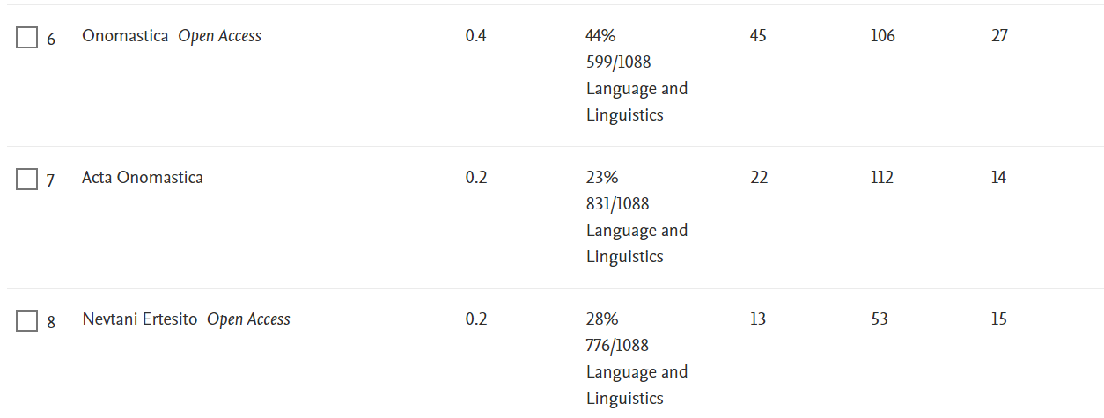

Slide 11
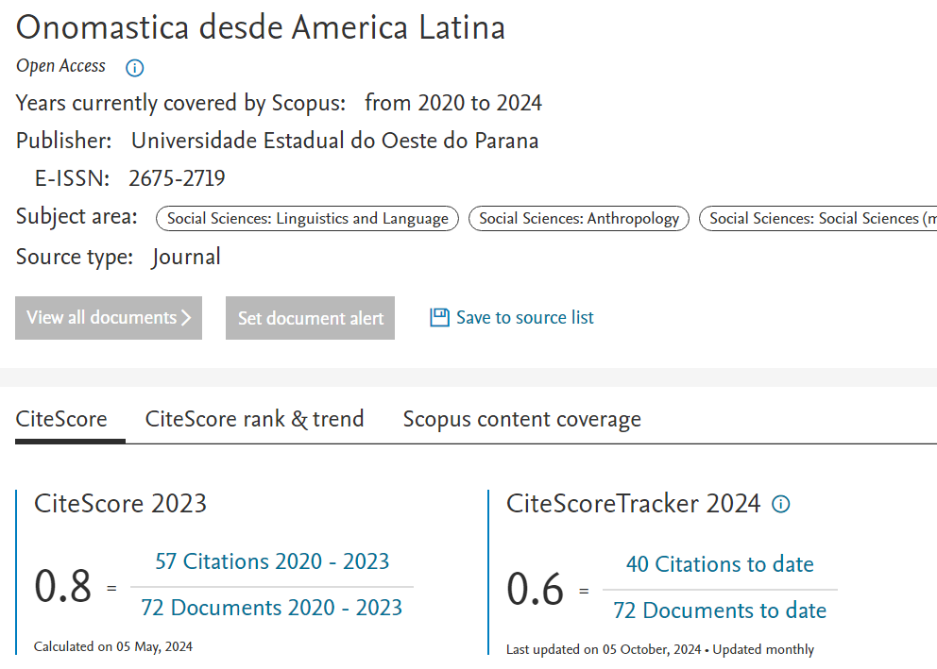
Example of Citation track 2024

Slide 12
Where the first 19 citations of ODAL in 2024 came from

Slide 13
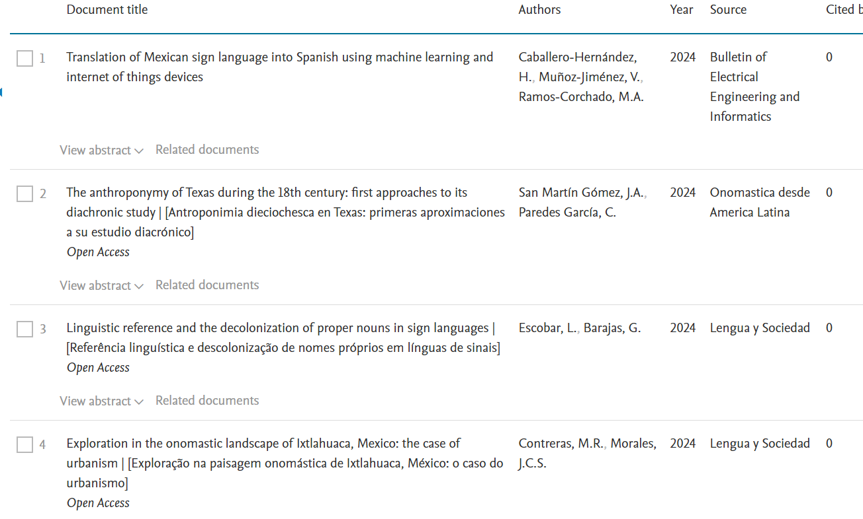

Slide 14
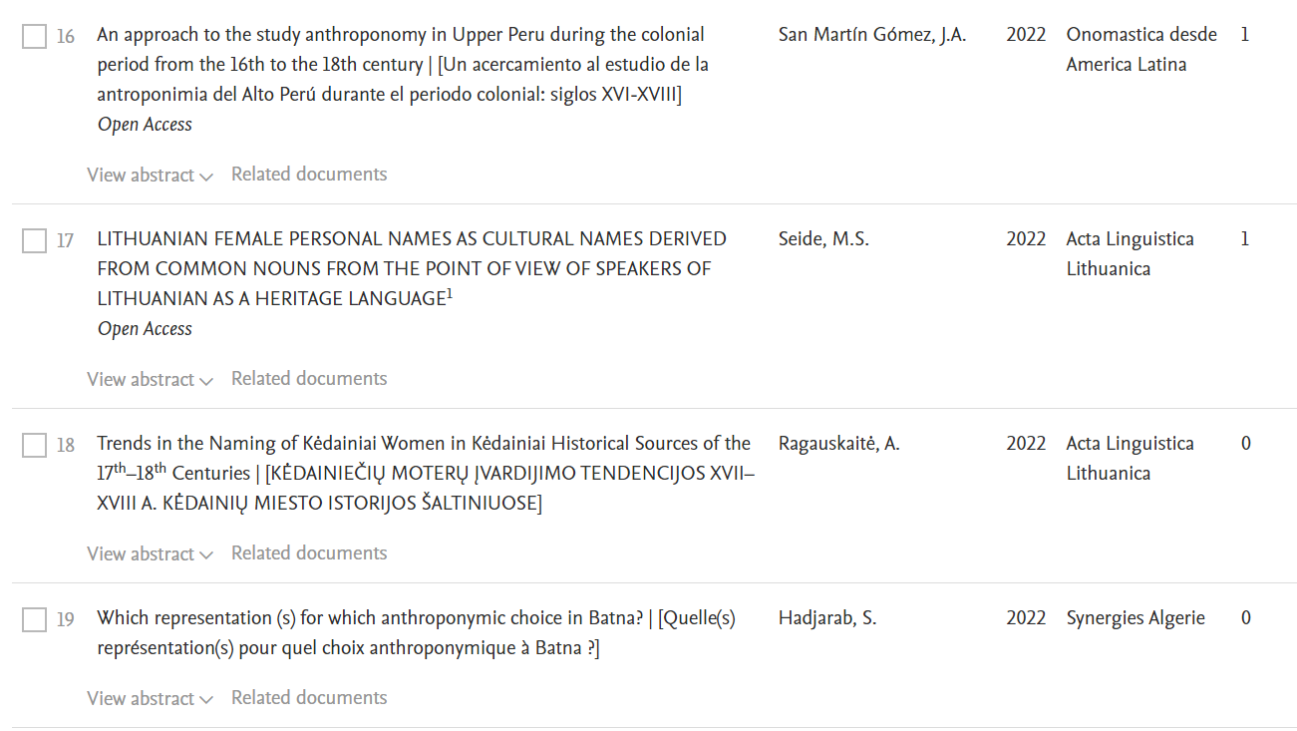

Slide 15
EXAMPLE OF PROTOCOL FOR A NEW SISTEMATIC REVIEW ARTICLE
Topic: Onomastic Terminology
Research Questions: What onomastic terms are used by researchers in Onomastics?
Are ICOS-recommended terms used?
Is terminological variation due to the coexistence of vernacular analytic terms with synthetic Greco-Latin terms?

Slide 16
Inclusion Criteria
Article on Onomastics journalpublished in 2023 or 2024,
Article written in one of the following languages: Portuguese. English, Spanish.
Articles published in the ONOMA
Articles published in journals reviewed by ICOS and indexed in SCOPUS
Articles on onomastics published in the GTLEX Magazine in Portuguese (non indexed jornal)
Articles on onomastics published in the Journal Domínios da Lingu@gem in Portuguese (non indexed jornal)

Slide 17
Articles are being selected
Acta Linguistica Lithuanica | n.88, 89, 90 e 91 (IN PRESS) | 2 English and....
Acta onomastica | 2 numbers by year | English
Folia onomastica Croatica | 2 numbers by year, 2024 (IN PRESS)) | 1 English
Names. | 4 numbers by year (n. 4.of 2024 (IN PRESS) | 30 English and....
Onomastica | 2 numbers by year, 2024 ((IN PRESS)) | 6 English and...
Voprosy onomastiki | V.20 (3 numbers.) and v. 21( N.1, others (IN PRESS)) | 8 English e ...
Onomastica desde America Latina Open Access | 2023 vol. and 2024 vol. | Portuguese 7 Spanish = 16 English = 5
GTLEx | 2024 (até 23/09) | Portuguese = 3
Domínios da Linguagem | 2023 | Portuguesa = 2
Onoma | 2 vol. by year (2024(IN PRESS)) | English = 15 and ....
 |  | Articles till now 101

Slide 18
Final remarks and contact
The review article can be written in the language chose by the author.
The author can invite coauthors to help writing the review article.
The review article should be published in a indexed Scopus jornal, prefereably an Open acess one.
E-mail for contact – marciaseda4@hotmail.com
Marcia.Seide@unioeste.br
WA 55 45 98828-96-76.

